Slide 1
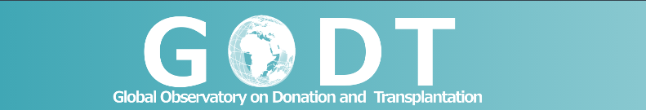


Organ Donation and Transplantation Activities
2014

Slide 2


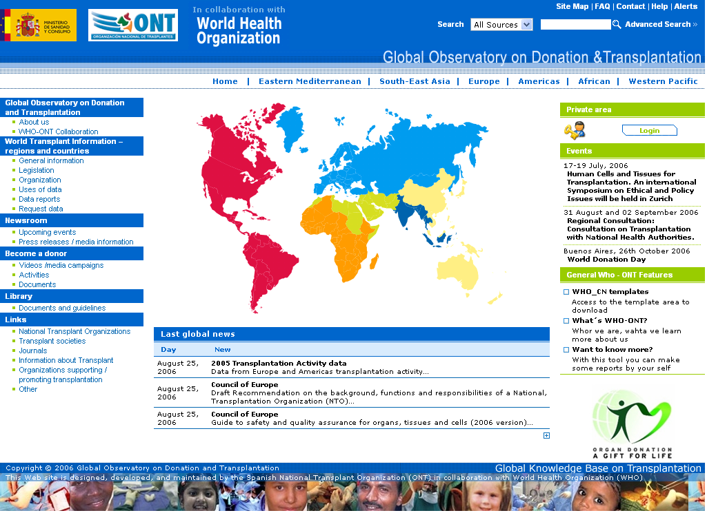
Global Activity in Organ Transplantation
2014 Estimates
GODT 2014
Kidney | Liver | Heart | Lung | Pancreas | Small bowel
79948 | 26151 | 6542 | 4689 | 2328 | 215
≈ 119,873 solid organs reported to be transplanted in 2014
≈ 1.81 % of increase over 2013
≤ 10% of global needs
41.6% of living kidney transplants and 19.8% of living liver transplants
Information of 107 Member States on organ transplantation activities is included in the GODT: 93 of 2014, 6 of 2013, 2 of 2012, 3 of 2011 and 3 of 2010.

Slide 3
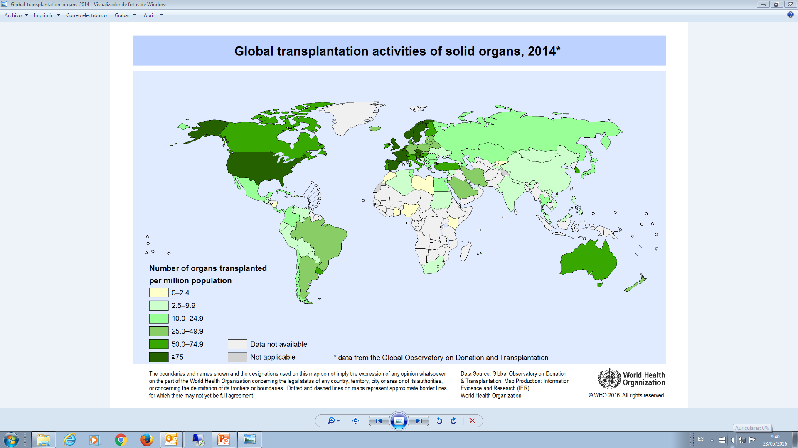

Slide 4
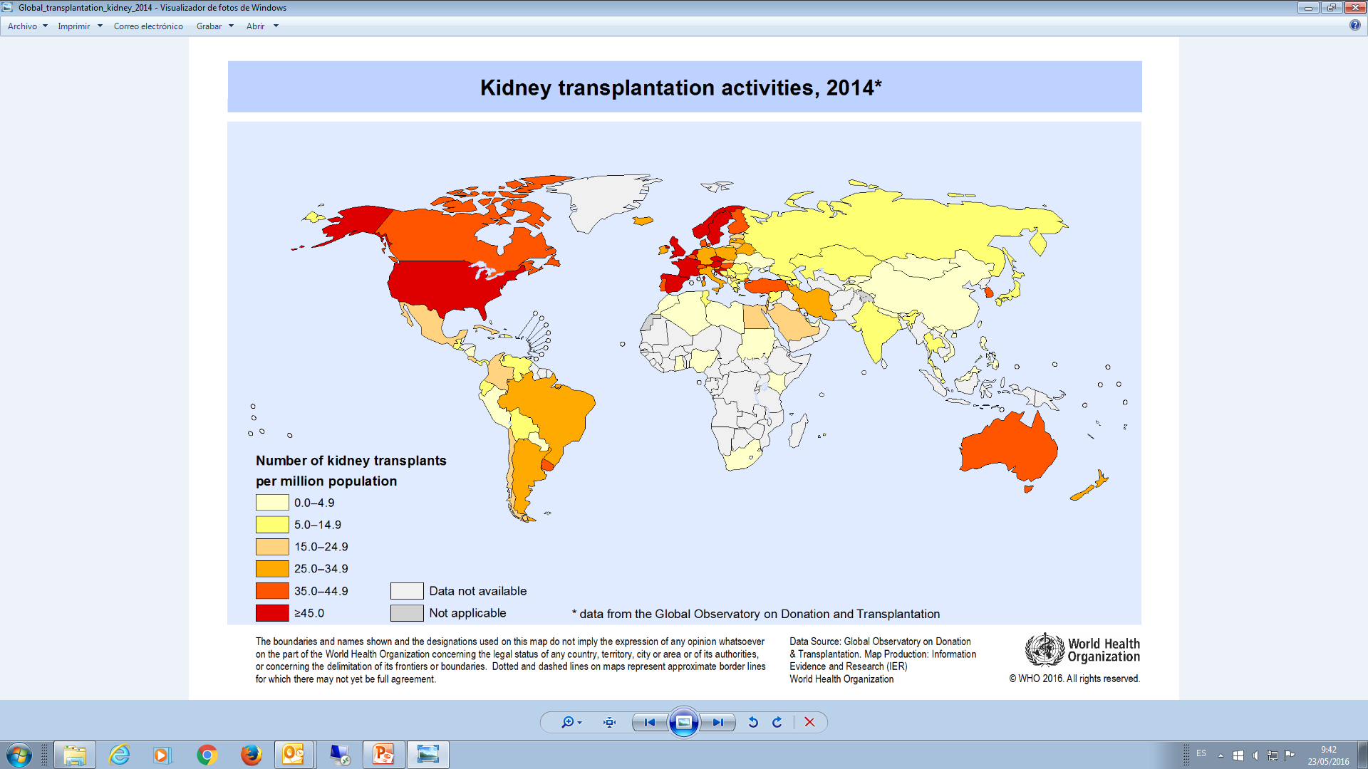

Slide 5
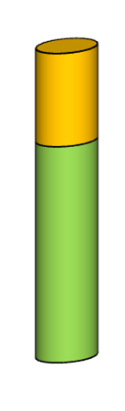
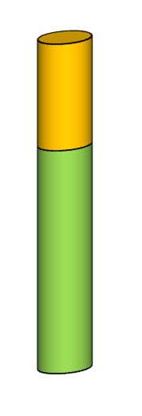
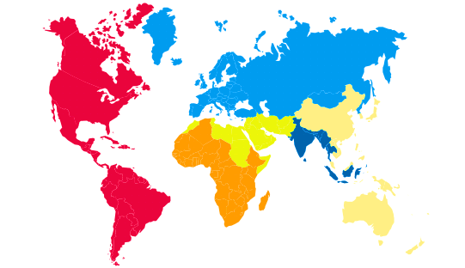
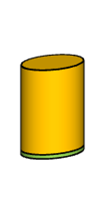
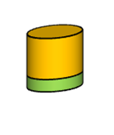
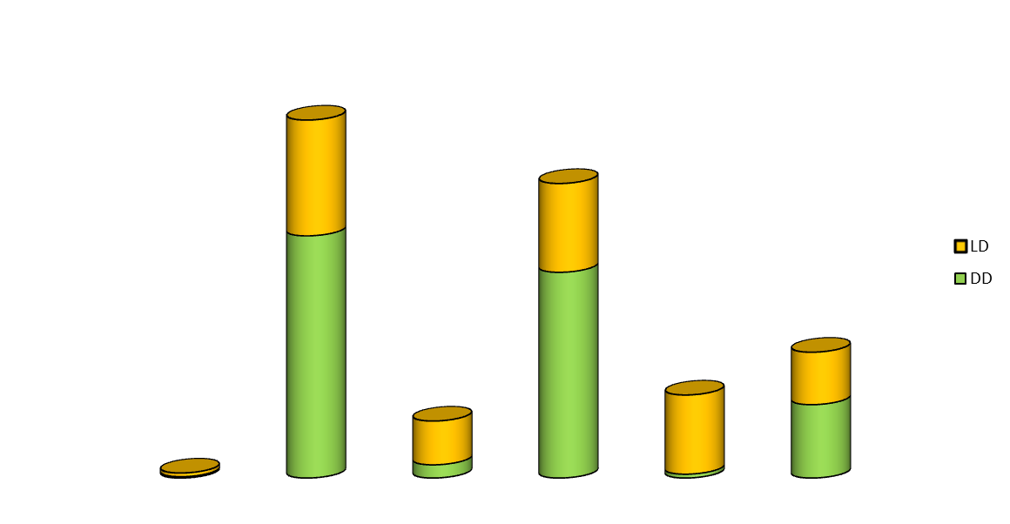
Kidney Transplantations per Region
Kidneys from Deceased Donors (%); Absolute number; Kidney Tx (pmp)
GODT 2014
Kidney from LD
Kidney from DD
69.8%
67.7%
25383 (27.9)
30849 ( 31.6)
25.3%
5290 (8.5)
4.65%
58.3 %
27.2%
7155 (3.8)
430(0.45 )
10841 (5.8)

Slide 6
Kidney Transplantations from deceased and living donors
Per million population (pmp)
GODT 2014
Rate Kidney tx from DD (pmp)
Rate Living Kidney tx (pmp)

Slide 7
Kidney Transplants per Country and Per million population (pmp)
GODT 2014
Kidney tx from DD (pmp)
Living Kidney tx (pmp)

Slide 8
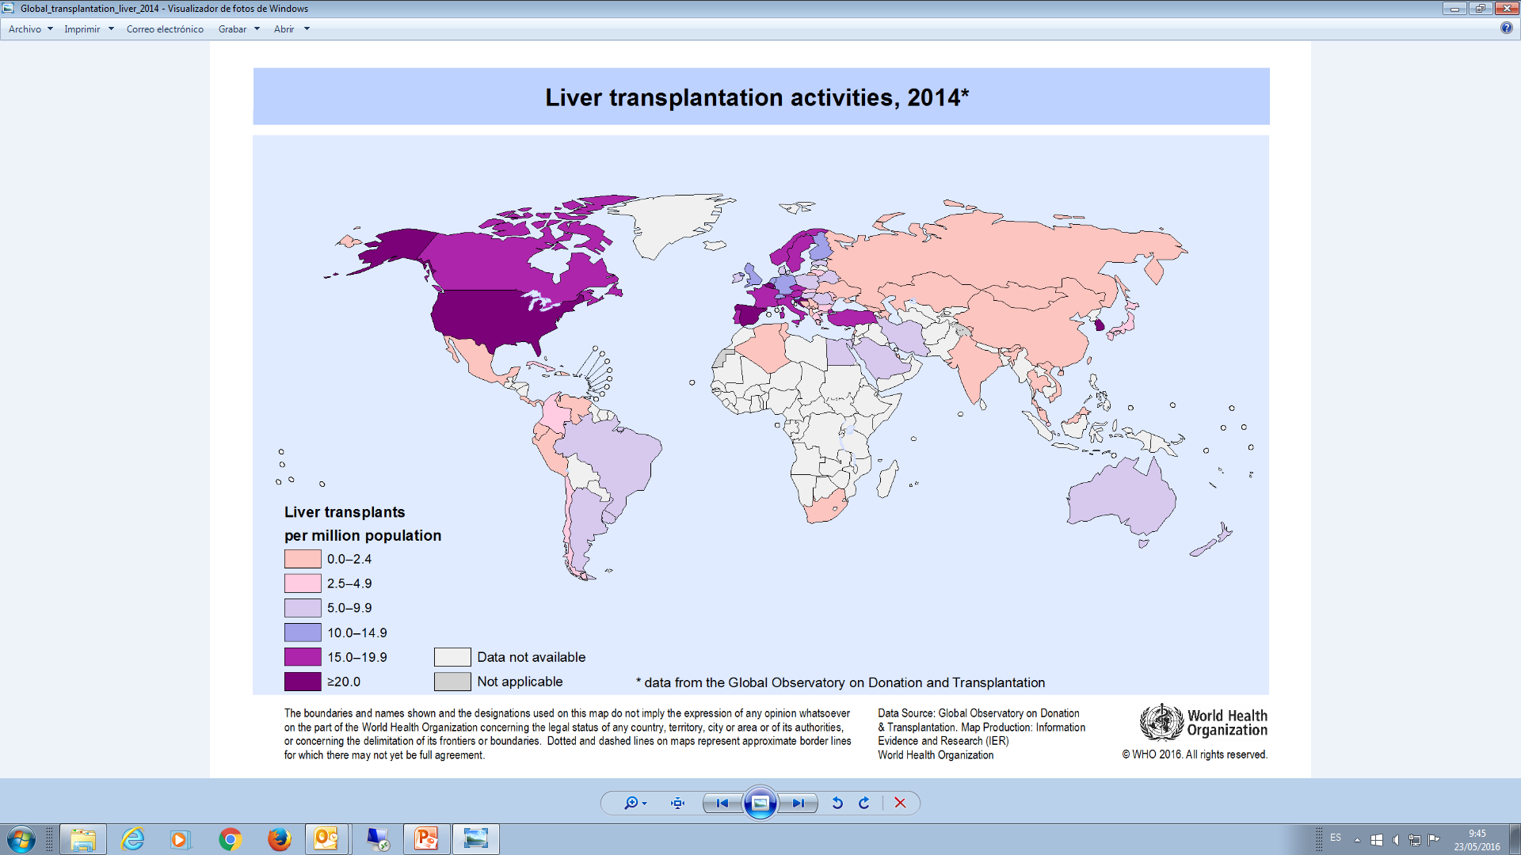

Slide 9
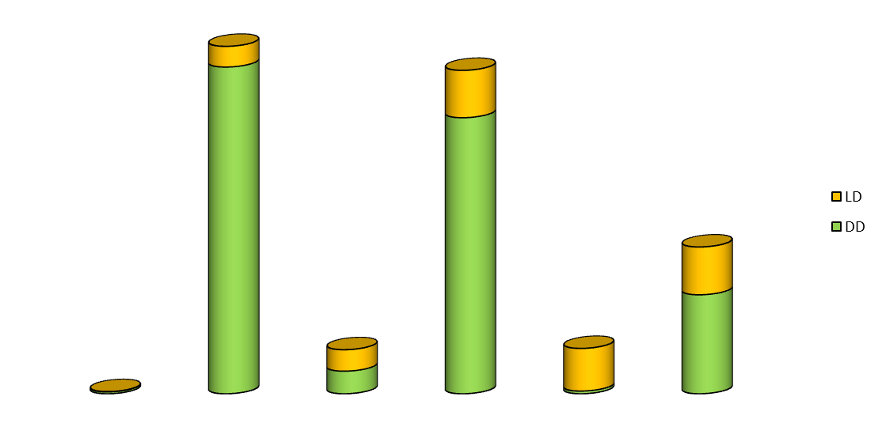
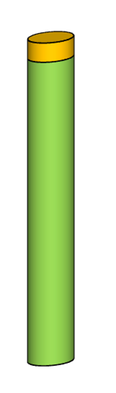
Liver Transplantations per Region
Livers from Live Donors (%); Absolute number; Liver Tx (pmp)
GODT 2014
Livers from LD
14.5 %
Livers from DD
5.9 %
9349 (10.28)
9974 (10.2)
32.6 %
49.2 %
4197 (2.25)
1274 (2.04)
94.1%
14.75 %
1296 (0.69)
61 (0.06)

Slide 10
Liver Transplantations from deceased and living donors
Per million population (pmp)
GODT 2014
Liver tx from DD (pmp)
Living Liver tx (pmp)

Slide 11
50 Most Active Countries Globally. Transplanted Organs per Million Population
GODT 2014
Kidney pmp
Liver pmp
Heart pmp
Lung pmp
Pancreas pmp
Small bowel pmp

Slide 12
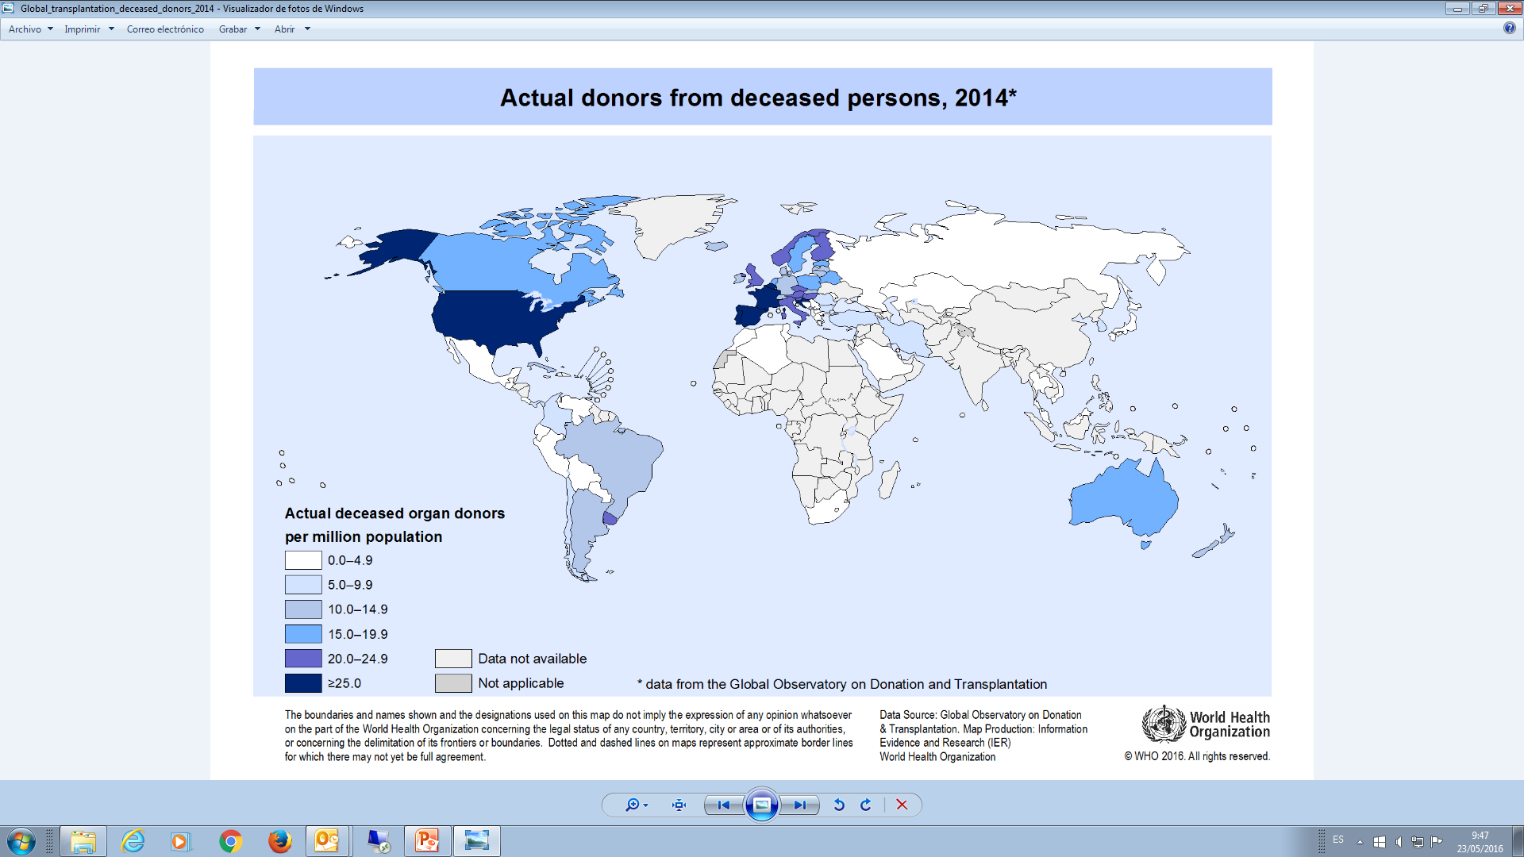

Slide 14
Total Kidney Transplants per million population vs
Human Development Index
GODT 2014
VERY HIGH HDI
Netherlands
LOW HDI
MEDIUM HDI
HIGH HDI
Iran
Argentina
Brasil
Chile
Syria
Nepal

Slide 15
Deceased donors per million population vs Human Development Index
GODT 2014
MEDIUM HDI
HIGH HDI
Croatia
VERY HIGH HDI
Uruguay
Australia
Brasil
Cuba
Argentina
Iran
Singapore

Slide 16
Disclaimer
The data and information presented here are published in order to promote transparency in transplantation activities.
Whenever possible this information has been confirmed by official national sources. However, in some instances, there are still provisional estimates. It is therefore anticipated that some data presented may be modified without prior notice.
As the facts displayed here are not definitive, they cannot be reproduced or quoted unless shown with the above warning and the date.
Data presented for South Africa and India are best estimates from official sources as health authorities are in the process of setting up comprehensive registries on organ transplantation.

